Slide 1
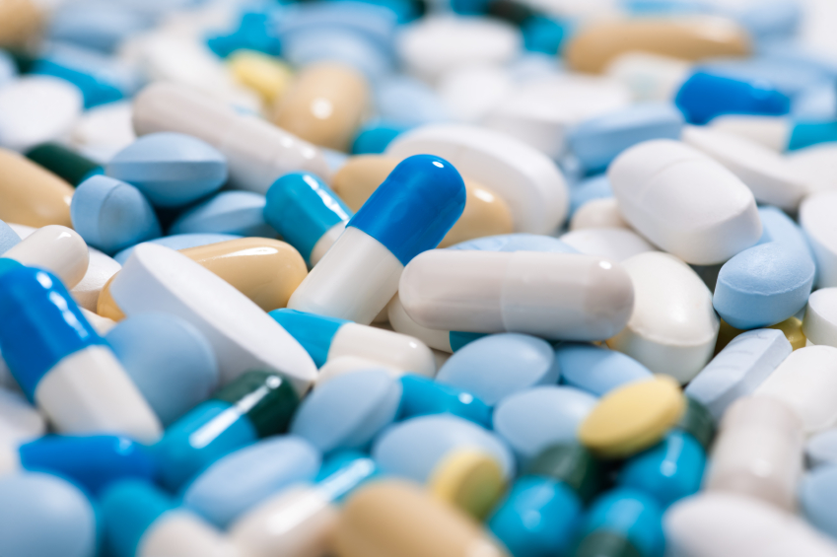
INTEGRATED VIEW OF HEALTHCARE DATA
Presented By:
Ayon Kar
Tapadyuti Maiti

Slide 2
OBJECTIVES
Optimize the drug discovery process in a much efficient way
Find a new drug for a particular gene based on the network modelling approach
Use all different kinds of chemical compounds to create a new drug
Chemical compounds from the available drugs
All new chemical compounds discovered
Pre clinical analysis is being thoroughly followed
Clinical trial and its assessment with valuable data is collected and reviewed
Distribution of drugs in hospitals, clinics and pharmacies based on requests received
Report the defected drugs

Slide 3
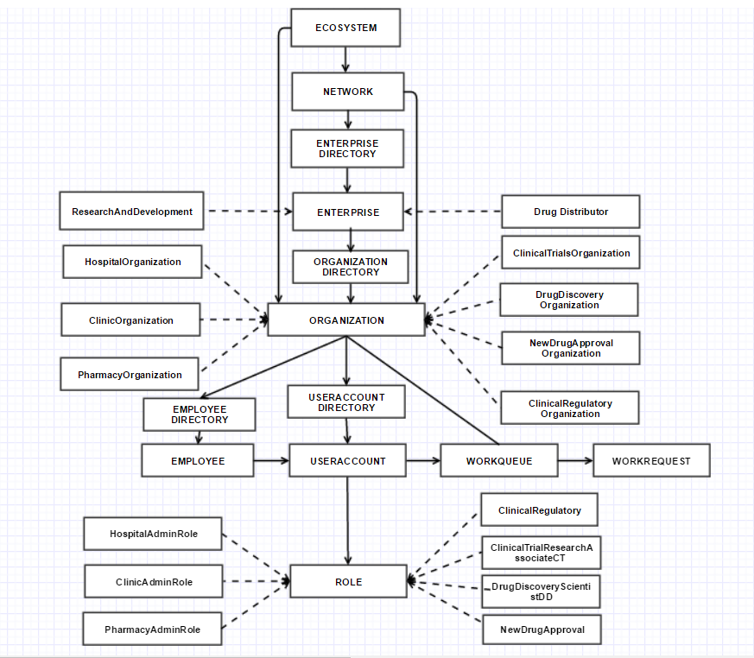
OBJECT MODEL

Slide 4
USE CASE (Drug Discovery)
Drug Scientist
Process by which new disease fighting compounds are effectively screened and identified
New drug for a particular gene identification based on the network modelling approach Different testing criteria are being used
Interconnectivity
Neighborhood Scoring
Network Propagation
Random Walk
Pre clinical studies is being done
Information on dosing and toxicity levels is captured
Appropriate dosage of drug is decided

Slide 5
USE CASE (Clinical Trials and Regulation)
Clinical Trial and Regulation
In Vitro analysis in being done thoroughly
Lab process for conducting In Vitro analysis
Phase1, Phase2, Phase3 is being conducted through to identify the drug effect on people
Clinical Regulatory body for investigation of new drug and its side effect
Safety and dosage in healthy/unhealthy patient is included

Slide 6
USE CASE (Drug Distributor)
Manage an organization
Add ‘Hospital’ Organization
Add ‘Clinic’ Organization
Add ‘Pharmacy’ Organization
Manage an employee
Creates employee for the organizations
Manage an user
Creates username and password for the employee

Slide 7
USE CASE (Hospital Admin)
Manage the drug supply
Receives a number requests from the hospitals
View or search a particular drug
Add the requested items to the cart
Modify or remove the drugs at any point of time
Sends the requested drug to the hospital
Report Against Drug
Receives a number of request from the hospital
Report a drug with a comment
The status of the drug will change to ‘Inactive’
An ‘Inactive’ drug will be removed from the hospital which requested for

Slide 8
USE CASE (Clinic Admin)
Manage the drug supply
Receives a number requests from the clinics
View or search a particular drug
Add the requested items to the cart
Modify or remove the drugs at any point of time
Sends the requested drug to the clinic
Report Against Drug
Receives a number of request from the clinic
Report a drug with a comment
The status of the drug will change to ‘Inactive’
An ‘Inactive’ drug will be removed from the clinic which requested for

Slide 9
USE CASE (PharmacyAdmin)
Manage the drug supply
Receives a number requests from the pharmacy
View or search a particular drug
Add the requested items to the cart
Modify or remove the drugs at any point of time
Sends the requested drug to the pharmacy
Report Against Drug
Receives a number of request from the pharmacy
Report a drug with a comment
The status of the drug will change to ‘Inactive’
An ‘Inactive’ drug will be removed from the pharmacy which requested for

Slide 10
FUTURE SCOPE
In vivo pre clinical test model
Implementation of Marketing Enterprise
BCG Analysis
PESTEL Analysis
Branding and Promotions
Drug Distribution Survey
Post Marketing Surveillance
Triggering notifications by sending mails for each changes made by the organization level admin to ensure the sysadmin is aware

Slide 11
References
https://www.stem.org.uk/system/files/elibrary-resources/legacy_files_migrated/33417-RSCPharmacokineticprocessesexcretion.pdf
http://www.organic-chemistry.org/prog/peo/cLogP.html
https://uab.edu/medicine/adda/images/131212%20PK%20ADME.pdf
http://www.genome.jp/dbget-bin/www_bget?hsa:3565

Slide 12
THANK YOU

